Slide 1
Steps:-
First copy the codes and save them via VS Code.
Then first open the login.html file, enter any name, phone number and email Id and then click on submit it will redirect you to the main Tube Lamp file.
On the tube lamp website just click the white button at bottom on the tube lamp and u will se the output. In the ppt too have added the screenshots of the lamp and output.
This is just one of my small project which I gave as a sample, there are many more Projects I have created also websites which if req. Ill surely show.

Slide 2
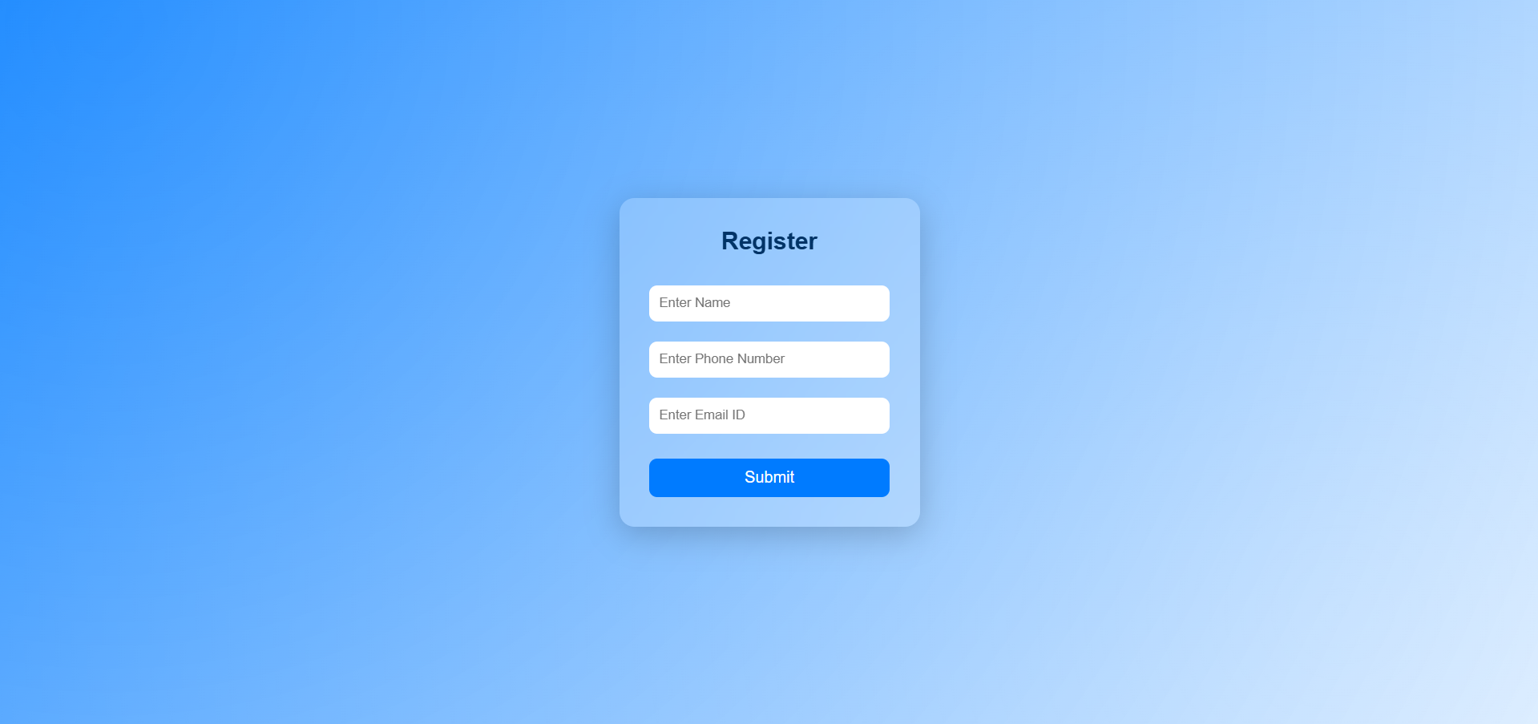

Slide 3
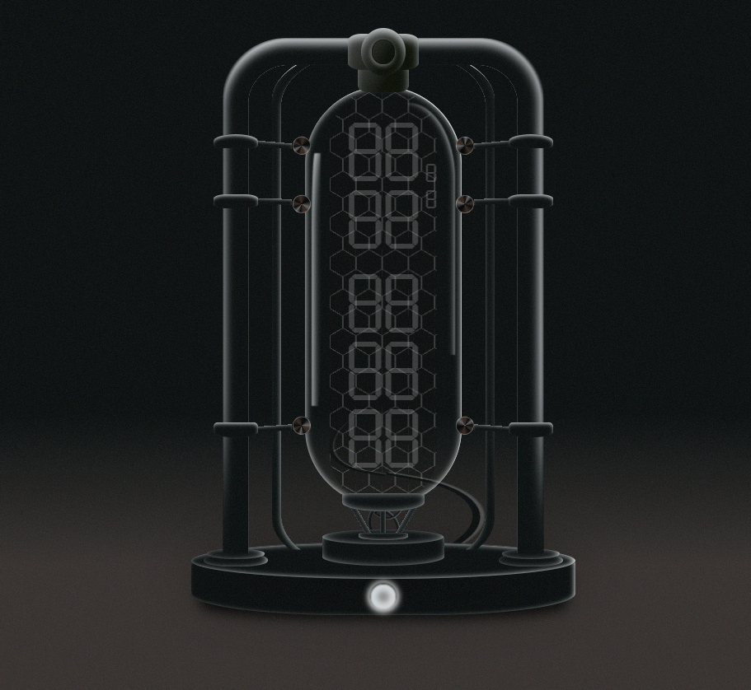
Notes:
Before Pressing Button.

Slide 4

Notes:
After clicking on button

